Slide 1
Executive Summary and Further Proposal
Diagnosing TB is indeed an issue in Nigeria and from my experience working HIV/AIDS health sector, it is known that The major cause of death for patients with HIV
Almost 60% of the estimated global HIV-related TB cases are not diagnosed and therefore not treated.
1/3 of all AIDS-related deaths in 2015.
A lot of Nigerian health centers are not equipped with the facilities and medical personnel to adequately diagnose TB.
AI has been used to predict TB diagnosis with 99.9% recall (sensitivity) in recent times.
Could this AI models be developed and customised to the work system using the available data at your teaching hospital?
Currently, I have built an AI model with 98% recall (results in the next slides) with the existing online datasets.
This way we can reduce work load, automate tasks, assist low resource clinics and the possibilities are quite endless.

Slide 2
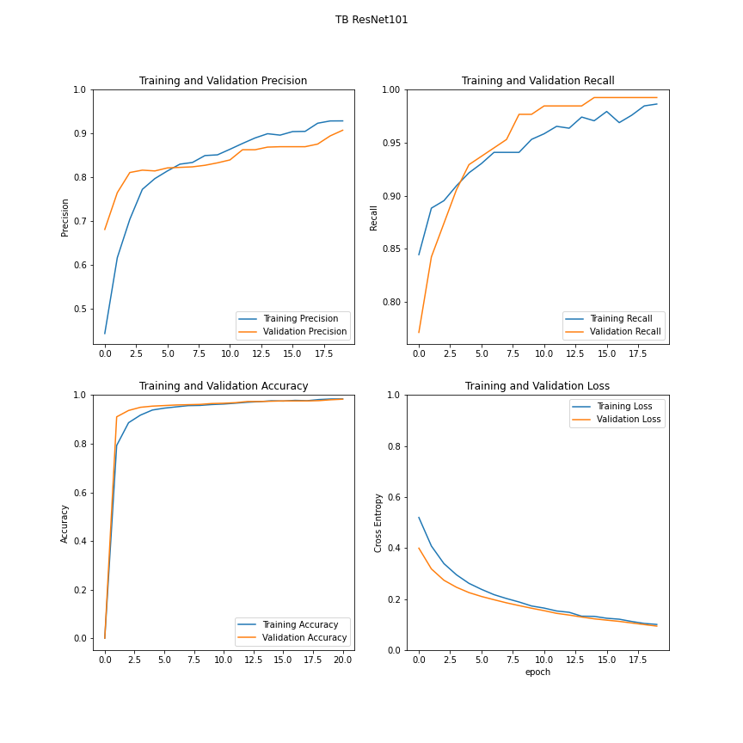
AI Model Evaluation Results

